Slide 1
Airbnb Team Number 4
Team Member | SJSU ID
Aniruddha Pratap Singh | 011432317
Gaurang Mahatre | 011432200
Jayam Malviya | 011435567
Kunal Ahuja | 010731227
Mayank Tanwar | 011435320
Prateek Sharma | 011475620

Slide 2
Performance Charts

Slide 4
Analytics
Admin Dashboard

Slide 5
User Activity Trace Diagram

Slide 10
Dynamic Pricing:
Dynamic pricing will be calculated using four parameters:
Property Clicks
User Reviews and Ratings
Property Rating
Festival Days Special Offer
User Loyalty

Slide 11
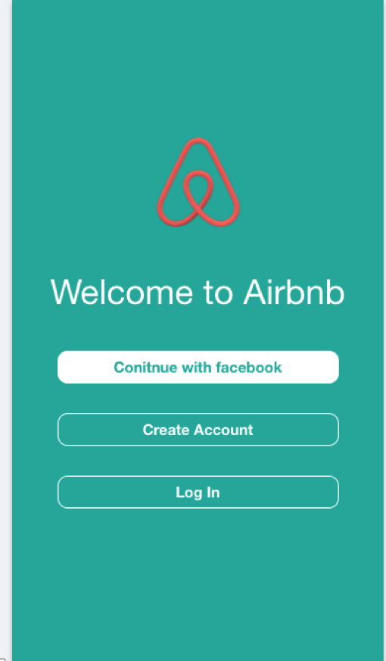
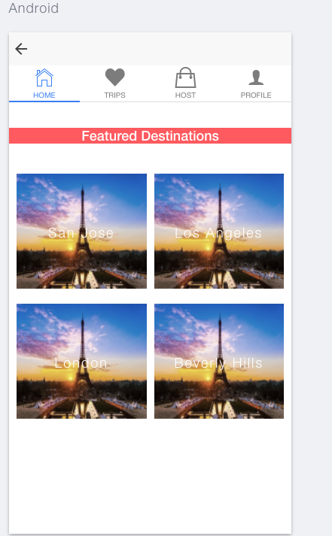

Slide 12
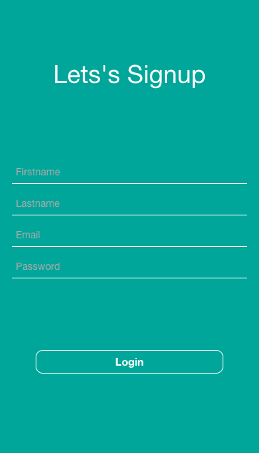


Slide 13

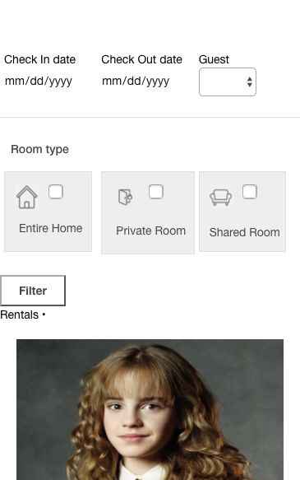


Slide 14
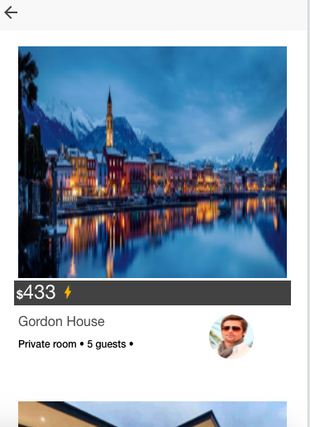
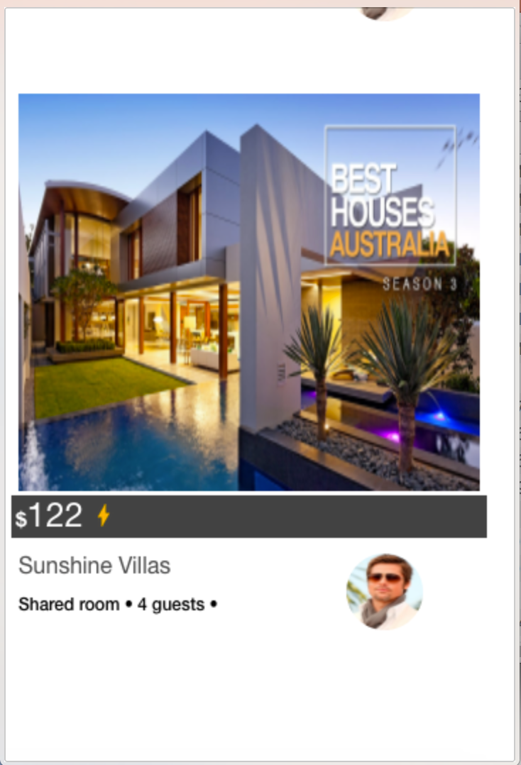

Slide 15
